Slide 1
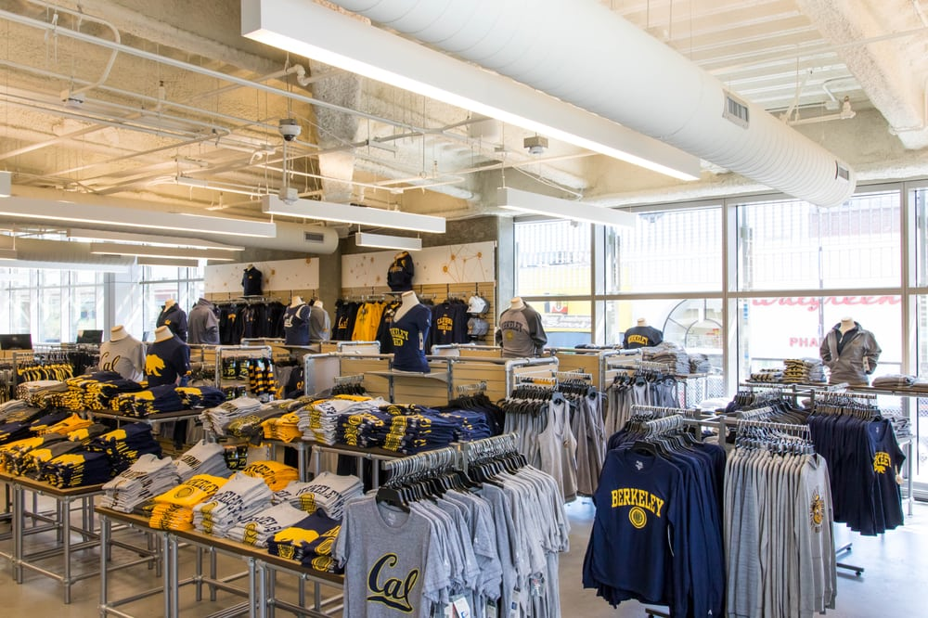

Database Design Project
Final Review

Slide 2


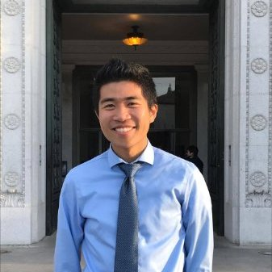
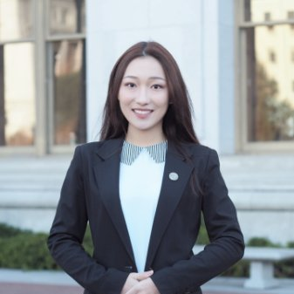


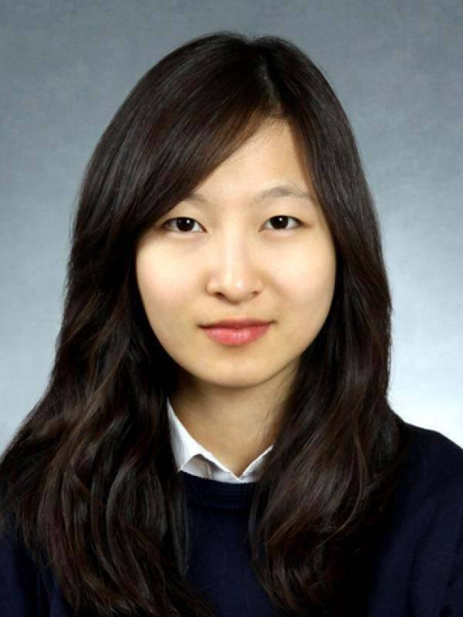
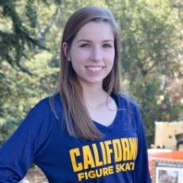

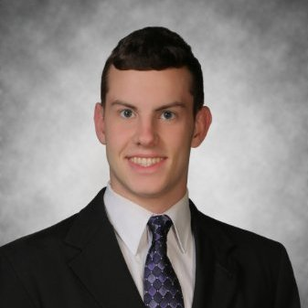

Meet the Team
Mimi Largier
IEOR
Ethan Kuo
IEOR
Annie Shi
ORMS & Stats
Nicky Lofgren
IEOR
Emma Hsu
IEOR & Econ
YunHee Kim
Stats & Math
Lucie Kresl
IEOR
Zhongling Jiang
Stats
Derek Sturgill
IEOR
Jinglin Zong
CS & Stats

Slide 3
Report Content
1
Client Summary
2
Database Design
3
SQL Queries
4
Normalization

Slide 4
Client Overview
Cal Student Store
With a Database
Distributes clothing, books, and accessories to the UC Berkeley community
Track merchandise items
Understand special events
Forecast future sales
Our database will increase understanding of sales trends and operations

Slide 5
Report Content
1
Client Summary
2
Database Design
3
SQL Queries
4
Normalization

Slide 6
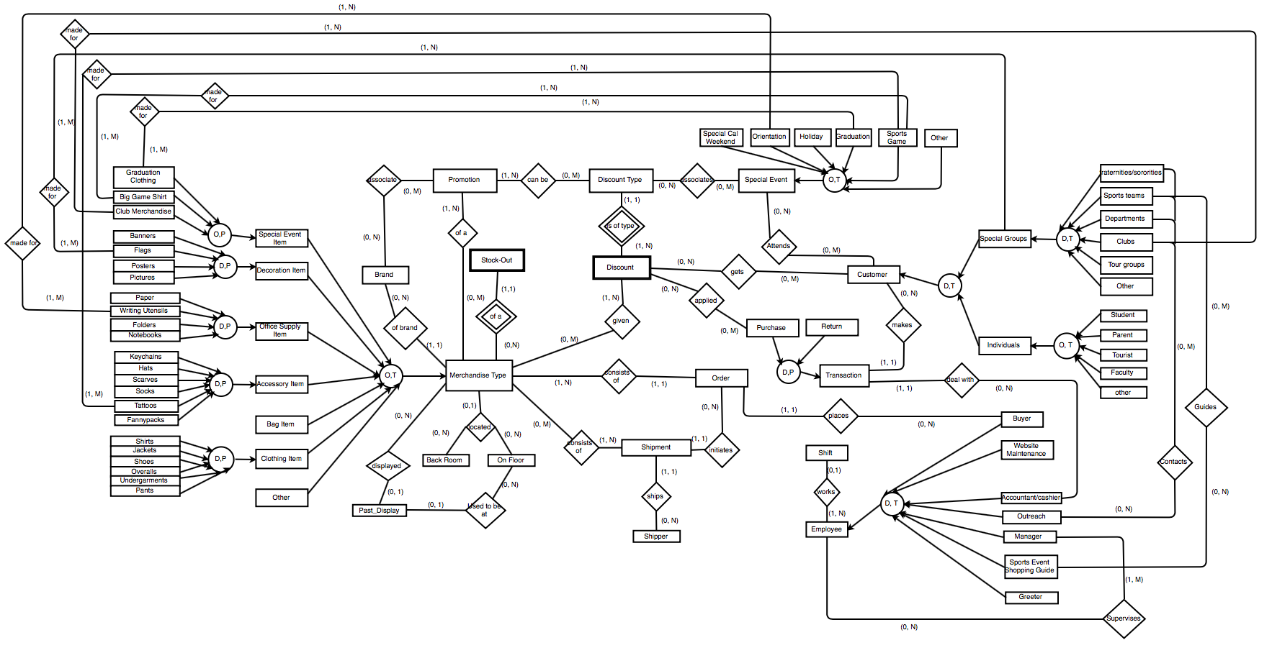
EER Diagram

Slide 7
Relational Schema
1. Merchandise (SKU, Category, Brand_ID³, Back_Room_ID¹⁷, On_Floor_ID¹⁸, price,
total_inventory_quantity, current, essential_item)
1a. Special Event Item (SKU¹, Name, Grad_Type, Color, Club_Merch_Type)
1b. Decoration item (SKU¹, Name, Color, Size, Material, Org_name, Description)
1c. Office Supply Item (SKU¹, Name, Size, Color, Ink, Tip_size, Pack_size, Paper_style,
Notebook_style, Folder_material, Page_num)
1d. Bag Item (SKU¹, Name, Size, Color, Gender, Style, Material)
1e. Accessory Item (SKU¹, Name, Color, Material, Style, Size, Gender, Organization_Name)
1f. Clothing Item(SKU¹, Name, Color, Gender, Material, Size, Style)
1g. Other(SKU¹, Description)
2. Discount (DIS_ID, Dis_start_date, Dis_end_date, Dis_type_ID¹³, SKU¹, Amount)
3. Brand (Brand_ID, Merchandise_type_sold)
4. Order (OID, EID¹¹, Order_date, Order_time, wholesale_cost)
5. Shipment (SHIP_ID, SHIPPER_ID¹⁸, OID⁴, Quantity, Price_of_goods, ship_date, arrival_date, ship_to,
ship_from, ship_cost)
6. Transaction (TID, EID¹¹, CID⁹, Date, Total_cost, Time, Weekday, DIS_ID²)
6a. Purchase (TID⁶, Purchase_type, Form_of_payment)
6b. Return (TID⁶, Return_type, Date_since_purchase, Quantity_reimbursed)
7. Transaction_Promotion(TID⁶, PID¹⁶)
8. Transaction_Product (TID⁶, SKU¹,Quantity)

Slide 8
Relational Schema (cont.)
9. Customer (CID, Fname, Lname, MI, Is_group)
9a. SpecialGroup (CID⁹ , category, group_name, num_members, sport, team_level, gender,
college_name, contact, club_name, club_description, tour_topic, other_name, description)
9b. Individual (CID⁹, category, age, gender, region, SID, year, major, num_children_attending,
visiting_from, date_visited, faculty_type, purpose/occasion)
10. Parent_cust_children(CID⁹, child_SID, child_name, child_year)
11. Employee (EID, title, Fname, Lname, MI, date_hired, managerID¹¹, wage, salary,
date_last_maintenance, cashier_number, outreach_area, management_area,
shopping_guide_focus_area)
12. BuysFrom(EID¹¹, BuysFrom_name)
13. Special Event (SE_ID, DIS_TYPE_ID¹⁵, start_date, end_date, weekend_name, expected_size,
holiday_name, sport_type, sport_gender, description)
14. Special Event Associated Customer (SE_ID¹³, CID⁸)
15. Discount Type (DIS_TYPE_ID, Discount_Description)
16. Promotion (PID, SKU¹, description, cost)
17. Back Room (Back_Room_Location_ID, Shelf_number, shelf_row, shelf_column)
18. On Floor (On_Floor_Location_ID, Store_Quadrant, Level)
19. Past_Display/Display_History (HID, On_Floor_Location_ID¹⁶,SKU¹)
20. Display_History_Dates(HID¹⁹, Date_Start, Date_End)
21. Stock-Out (Date, SKU¹, reorder_date)

Slide 9
Relational Schema (cont.)
22. Shipper (SHIPPER_ID, Fname, Lname, MI, location)
23. Shift (Shift_ID, start_time, end_time, shift_date)
24. Shift_worker(Shift_ID²³, worker_ID)
25. Junction_Drawstring_Orientation (SKU¹, SE_ID¹³)
26. Junction_WritingUt_Orientation (SKU¹, SE_ID¹³)
27. Junction_Tattoo_SportsGame (SKU¹, SE_ID¹³)
28. Junction_BigGameShirt_SportsGame (SKU¹, SE_ID¹³)
29. Junction_Flags_SpecialGroups (SKU¹, CID⁹)
30. Junction_ClubMerchandise_Club (SKU¹, CID⁹)
31. Junction_GraduationClothing_Graduation (SKU¹, SE_ID¹³)
32. Junction_Brand_Promotion (Brand_ID³, PID¹⁶)
33. Junction_Promotion_DiscountType(PID¹⁴, DIS_TYPE_ID¹⁵)
34. Junction_DiscountType_SpecialEvent(DIS_TYPE_ID¹⁵, SE_ID¹³)
35. Junction_SpecialEvent_Customer (SE_ID¹³, CID⁹)
36. Junction_Discount_Customer (DIS_ID², CID⁹)
37. Junction_Discount_Purchase (DIS_ID², TID⁶)
38. Junction_Discount_Merchandise (DIS_ID², SKU¹)
39. Junction_Merchandise_Shipment (SKU¹, SHIP_ID⁵)
40. Junction_Merchandise_Promotion (SKU¹, PID¹⁶)
41. Junction_Employee_Manager (EID¹¹, EID¹¹)

Slide 10
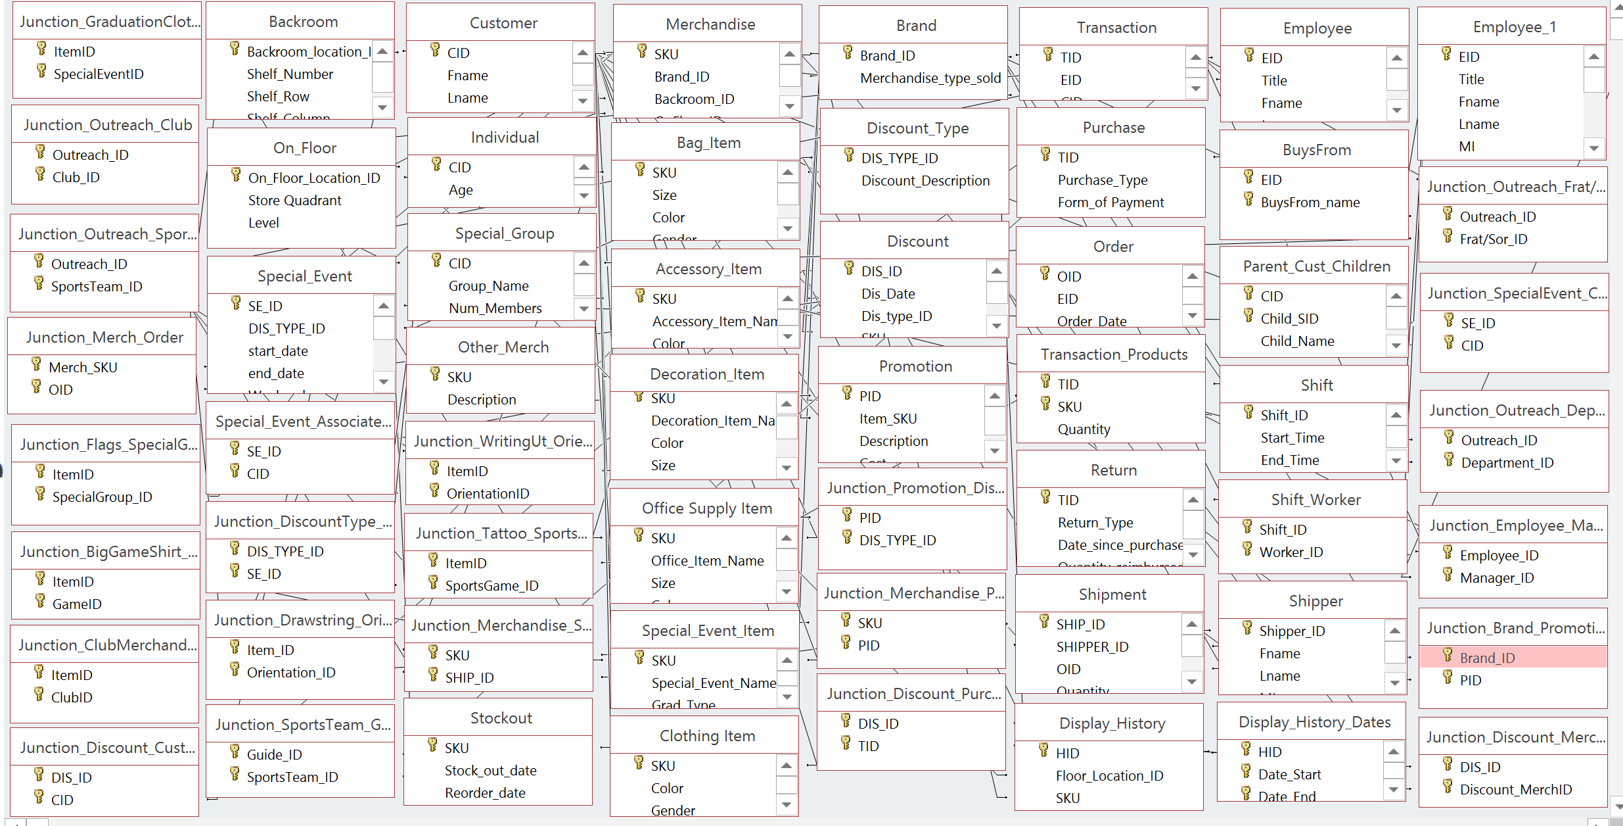
Access Relationship View

Slide 11
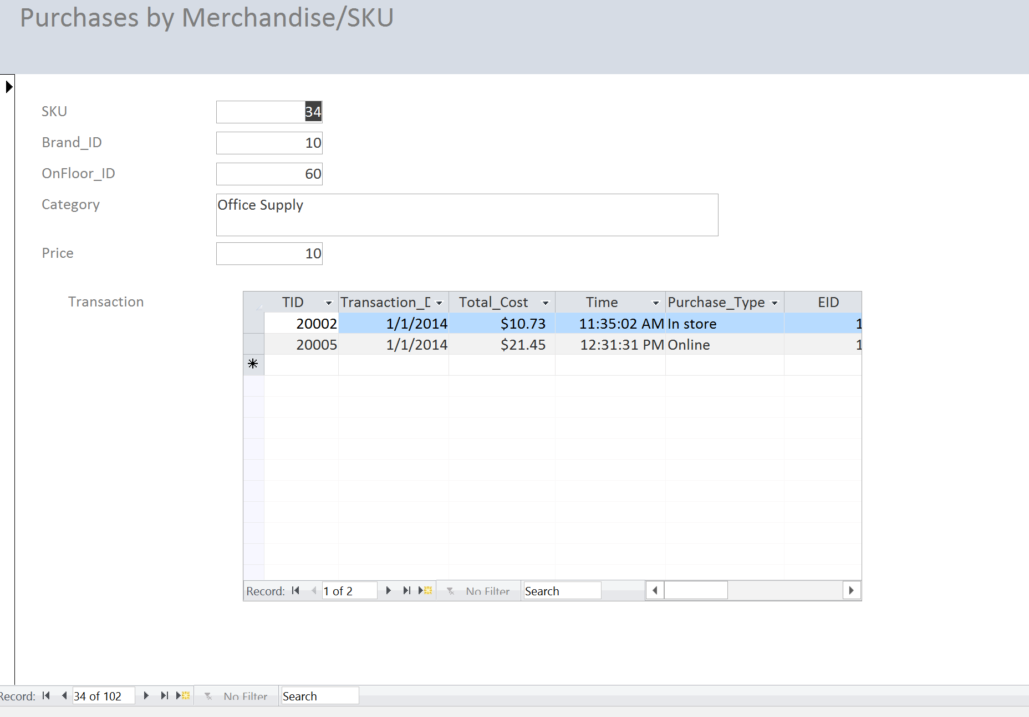
Access Form Purchases by SKU

Slide 12
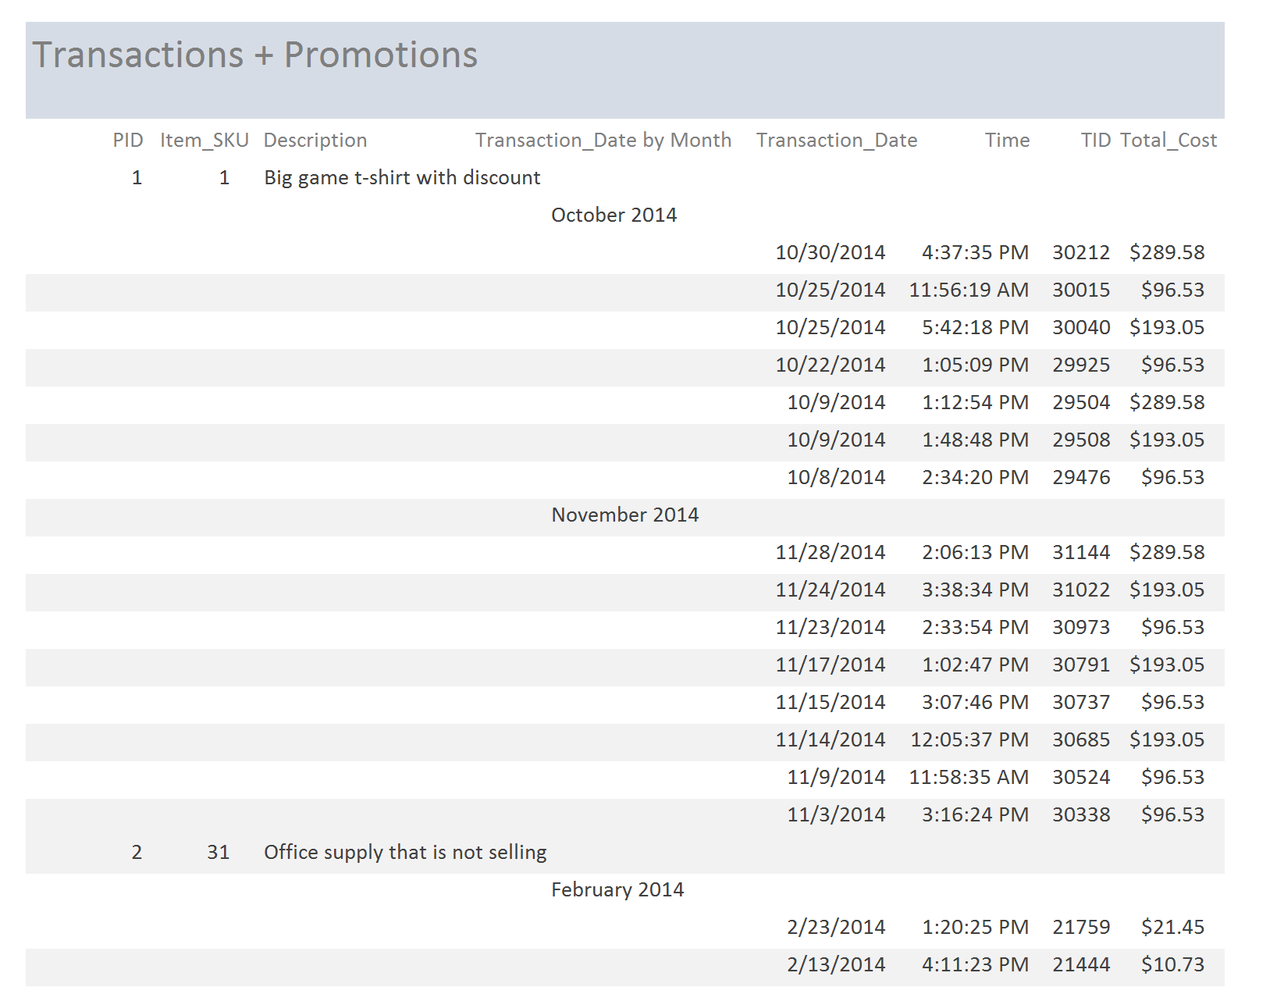
Access Report Transactions & Promos

Slide 13
Report Content
1
Client Summary
2
Database Design
3
SQL Queries
4
Normalization

Slide 14
Query #1 Worker Prediction
Purpose:
Run simulations to determine the optimal amount of workers
Business Justification:
Cal Student Store could save money by finding out when multiple workers are needed for peak times and only having extra workers for those hours
Mathematical Model:
Use Sigma and Simio with varying arrival times to determine the maximum number of workers needed at peak times based on demand
Predict optimal number of workers
Overview | Math | SQL | Results

Slide 15
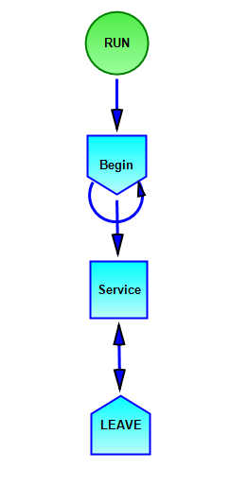
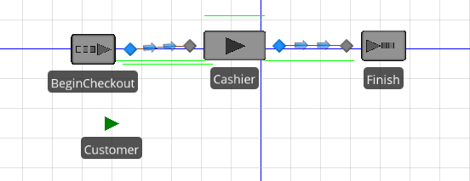
Query #1 Mathematical Models
Sigma
Simio
Overview | Math | SQL | Results

Slide 16
Query #1 SQL
Weekday data:
SELECT t.Time, sum(tp.quantity)
FROM Transaction as t, Transaction_Product as tp
WHERE Weekday = 1 and t.TID = tp.TID
GROUP BY tp.TID
Weekend data:
SELECT t.Time, sum(tp.quantity)
FROM Transaction as t, Transaction_Product as tp
WHERE Weekday = 0 and t.TID = tp.TID
GROUP BY tp.TID
Overview | Math | SQL | Results

Slide 17
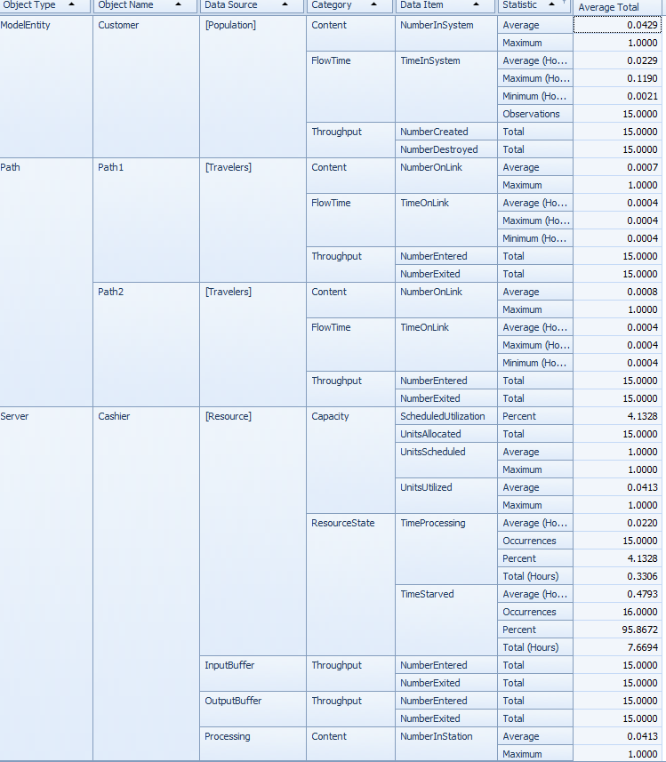
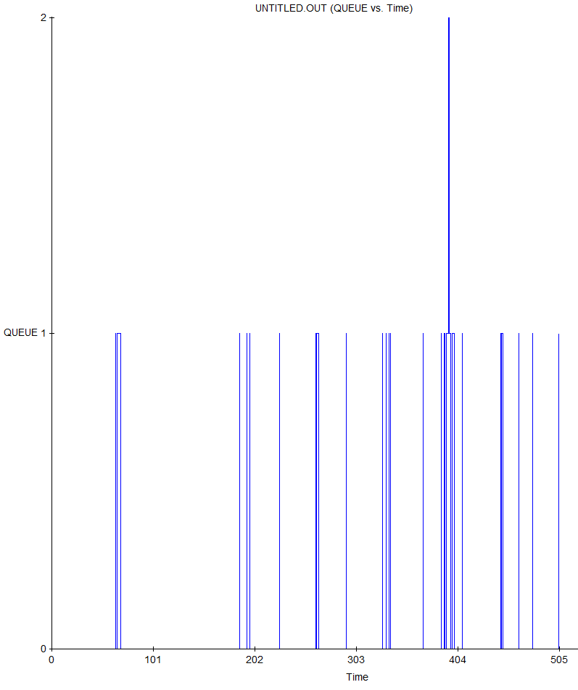
Query #1 Sigma/Simio Implementation
Arrival time and service time fit exponential distribution (using Easyfit)
Input distributions into Sigma and Simio
Overview | Math | SQL | Results

Slide 18
Query #1 Sigma/Simio Results
Utilization rate when wait time is exponential of 5 minutes
Approximate worker utilization rate
4.5%
30%
Our Recommendation
1.
One worker should be sufficient to staff all store functions
2.
Consider the value of a greeter to add to employment
Overview | Math | SQL | Results

Slide 19
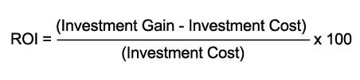
Query #2
Promotion Effectiveness
Purpose:
Checks each promotion’s effectiveness.
Business Justification:
For each promotion category, we will produce a rating that is calculated by using its return on in-vestment (ROI) method. Through this query our client will be able to see which promotion provid-ed profit and which resulted in a loss.
Statistical Model:
ROI is attained by calculating total revenue of investment subtract by cost of investment and dividing this with cost of investment (ROI = (Revenue of Investment - Cost of Investment ) / Cost of Investment). The output of the query will be promotion’s ID, Cost, Revenue, and the rated rank.
Help the Cal Student Store to determine which promotion to emphasize
Overview | Math | SQL | Results

Slide 20
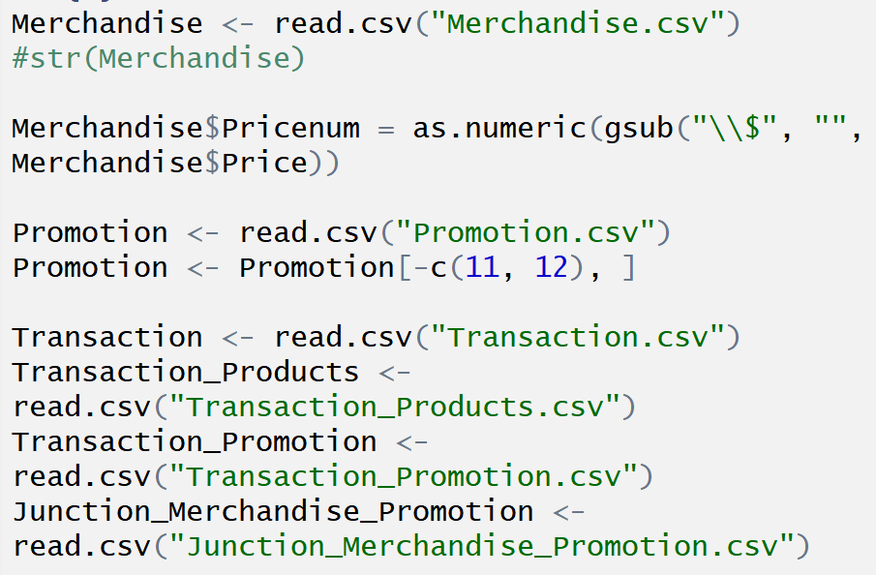
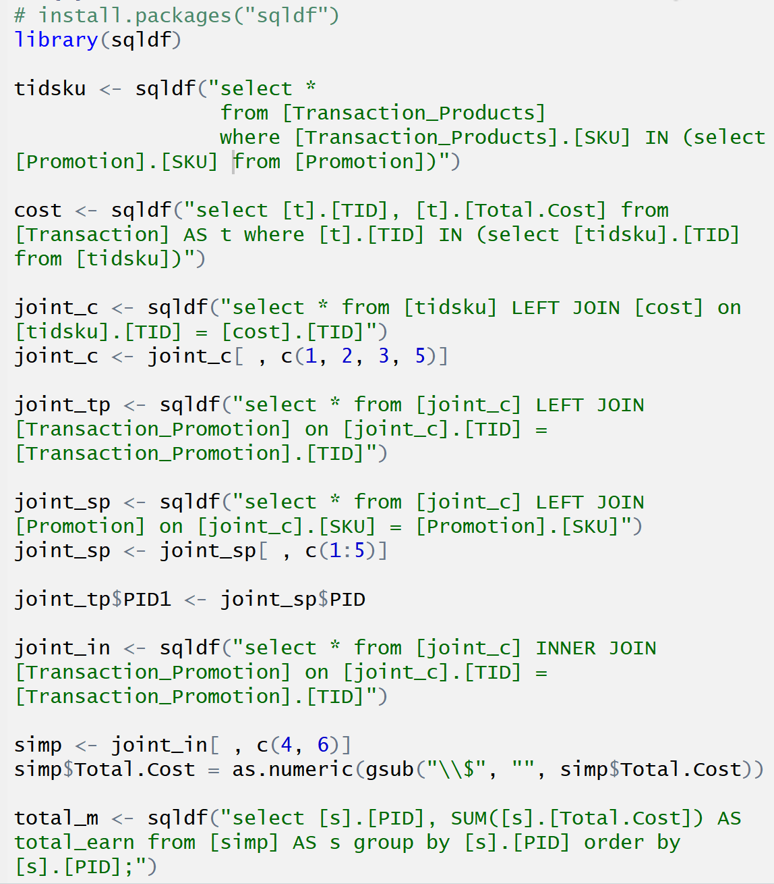
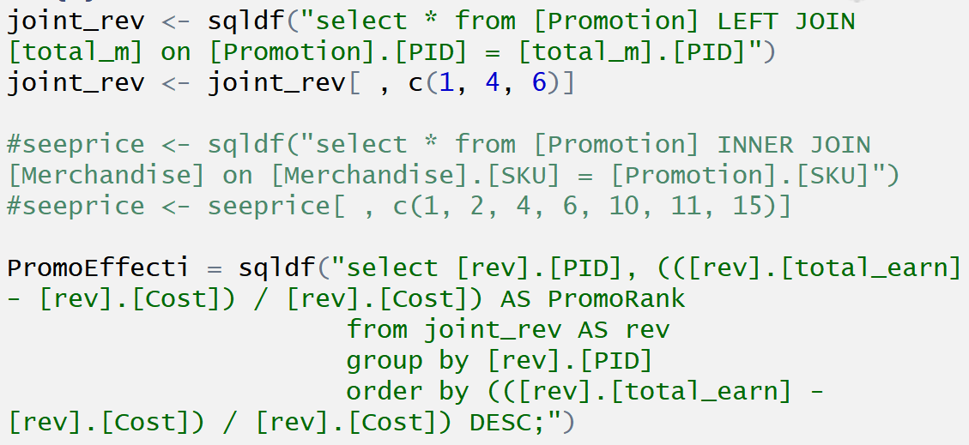
Query #2 SQL in R
1
2
1
2
3
Overview | Math | SQL | Results

Slide 21
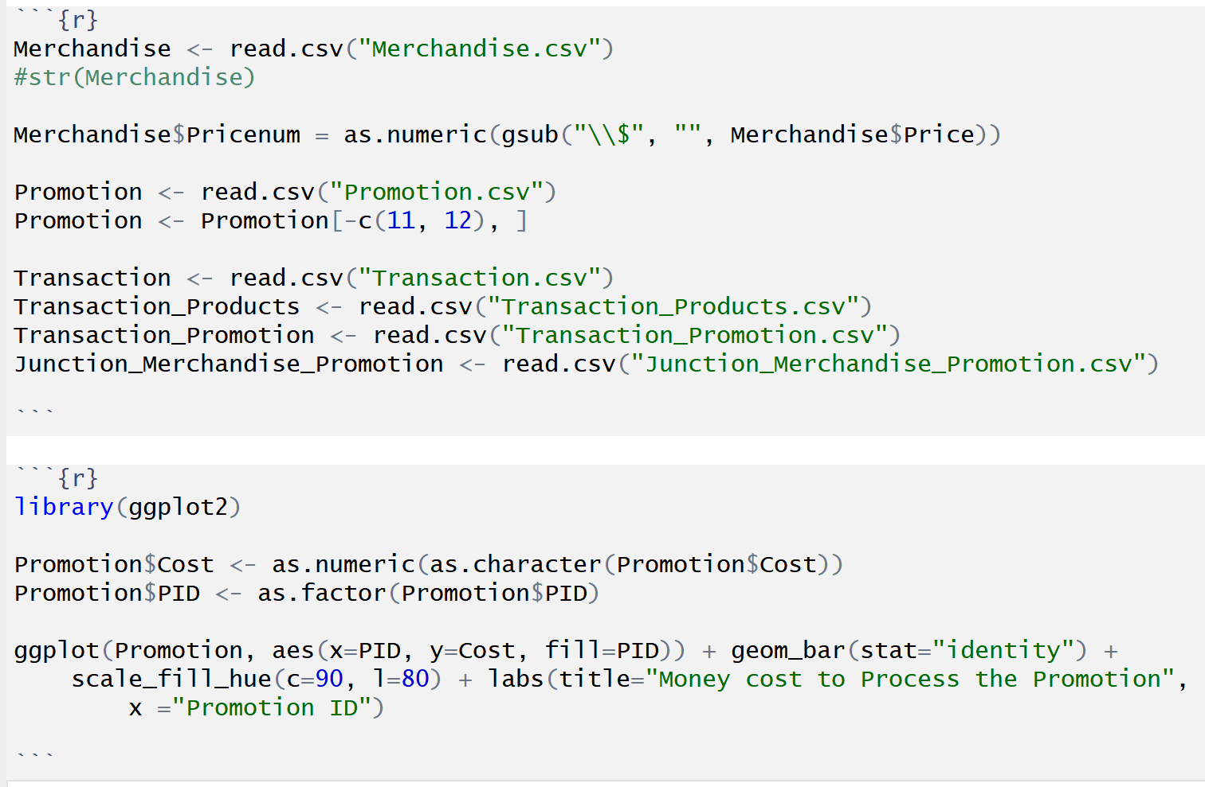
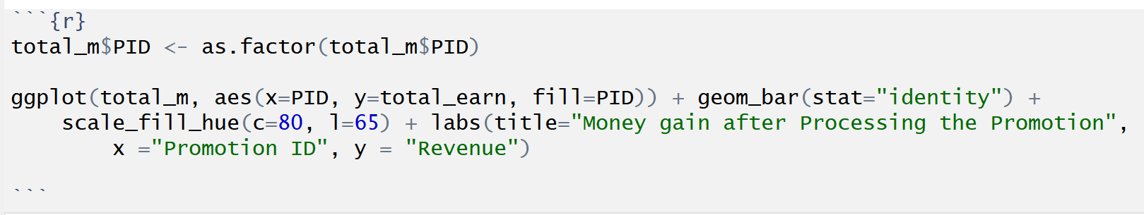
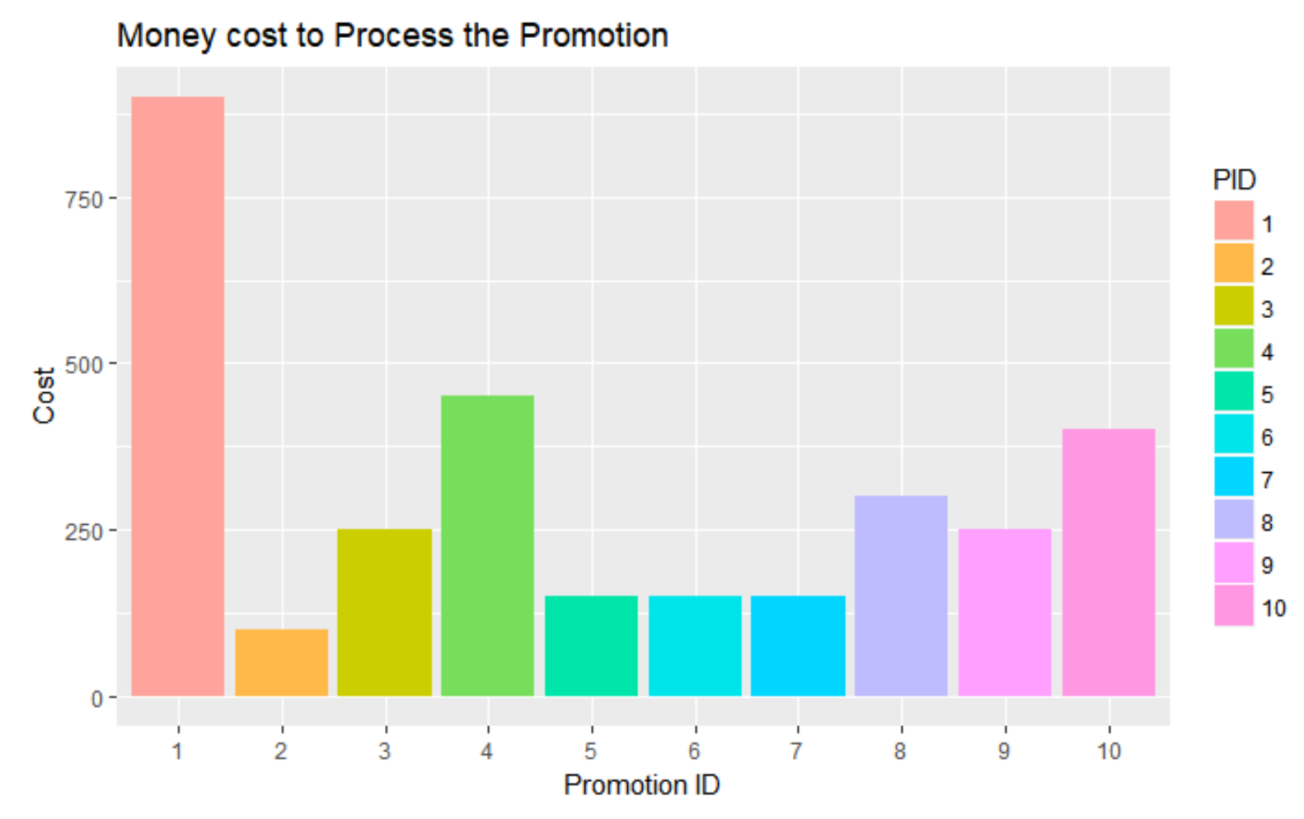
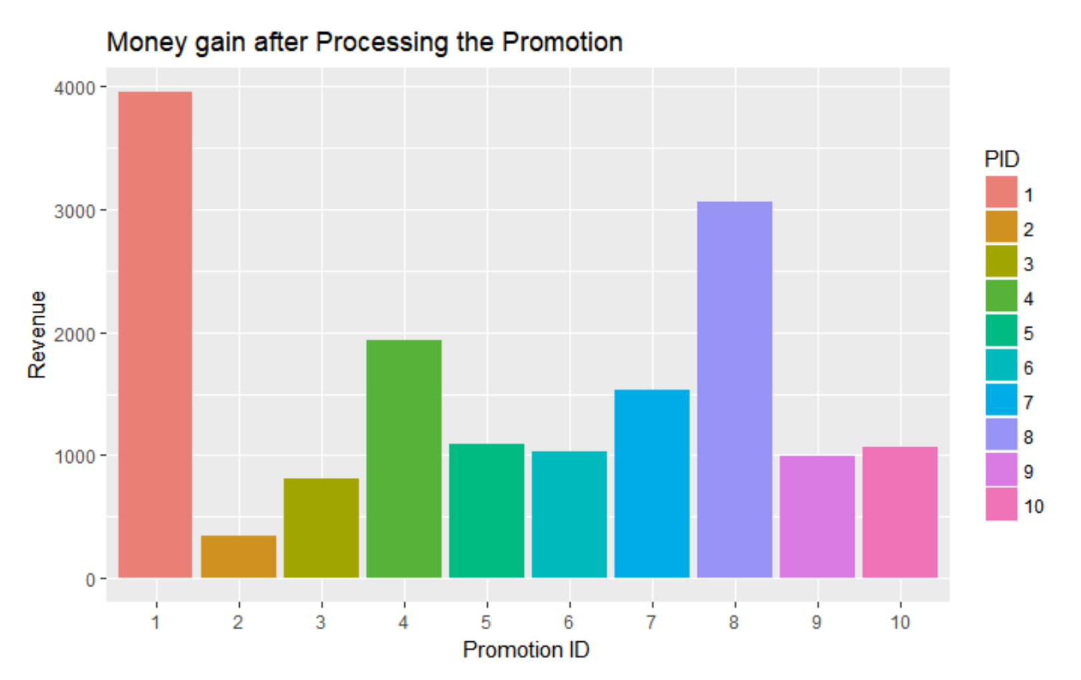
Query #2 Cost vs. Gain
Overview | Math | SQL | Results

Slide 22
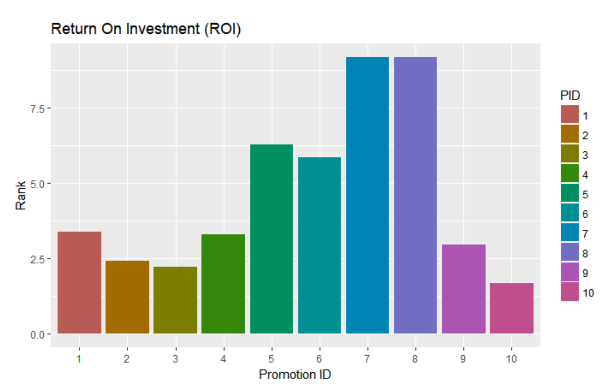
Query #2 ROI Method
After applying ROI, the result is different to what we initially thought
Overview | Math | SQL | Results

Slide 23
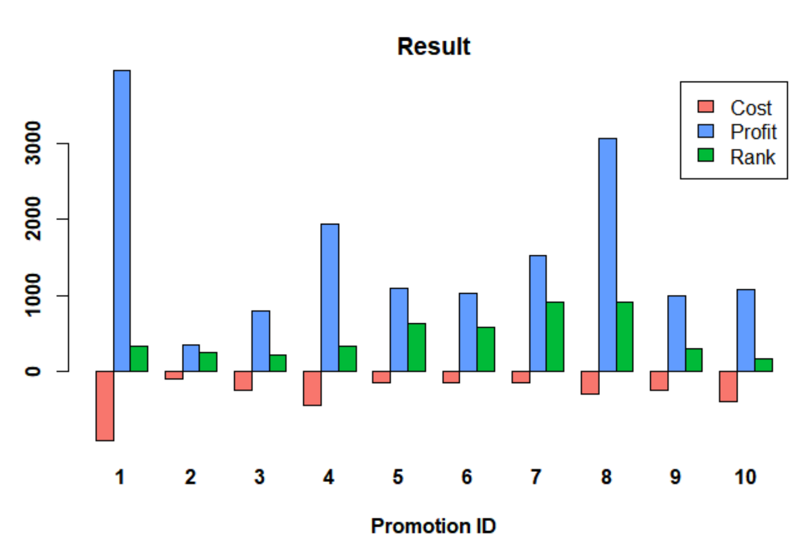
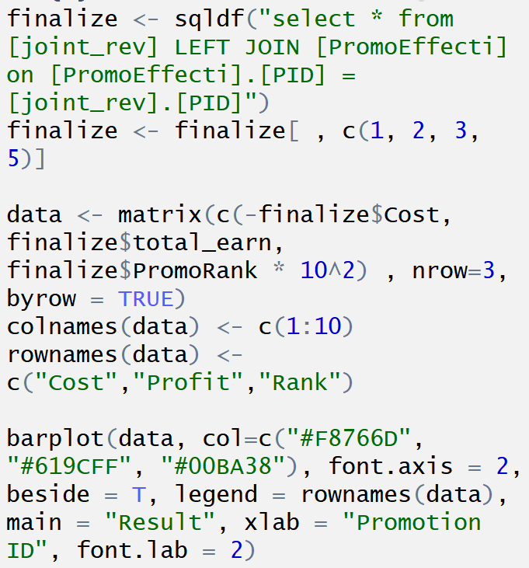
Query #2 Final Rankings
Final ROI rankings for each promotion are now able to be determined
Overview | Math | SQL | Results

Slide 24
Query #3 Product Location
Purpose:
Determine the most profitable way to place products in the on floor locations in the store.
Business Justification:
Running this query and performing the optimization allows the client to maximize profits by strategically placing products around the store, based on existing relationships between sales revenue and in-store location.
Mathematical Model:
Rank each in-store location’s optimal products by revenue generated, then solve a linear programming problem maximizing profit constrained by store space.
Maximize revenue through optimal product in-store location
Overview | Math | SQL | Results

Slide 25
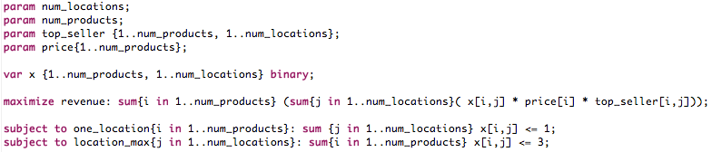
Query #3 AMPL Model
Objective:
Maximizes the total revenue across all locations in the store
Constraints:
A product can only be in one location at a time
A location can have at most three products placed in it
Output:
Returns a binary variable for each product-location pair, indicating whether or not the product is placed there
Overview | Math | SQL | Results

Slide 26
Query #3 SQL
1.) Determine the Top 10 products for each on floor location:
SELECT TOP 10 dh.ON_floor_location_ID AS Floor_Location, dh.SKU AS Product, AVG(tp.quantity * m.price) AS Revenue
FROM Display_History AS dh, Display_History_Dates AS dhd, Merchandise AS m, On_Floor AS f, [Transaction] AS t, Transaction_Products AS tp
WHERE dh.ON_floor_location_ID = 3
AND dh.HID = dhd.HID
AND dh.SKU = tp.SKU
AND m.SKU = tp.SKU
AND tp.TID = t.TID
AND t.date between dhd.Date_Start and dhd.Date_End
GROUP BY dh.SKU, dh.ON_floor_location_ID;
2.) Extract the prices of each product:
SELECT SKU AS Product, price AS Product_Price
FROM Merchandise;
Overview | Math | SQL | Results

Slide 27
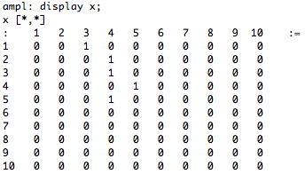
Query #3 Data Output
AMPL output for the first 10 products reveals:
1
Product should be placed in this floor location
0
Otherwise
Each column represents a different in store location
Each row represents a different product
Overview | Math | SQL | Results

Slide 28
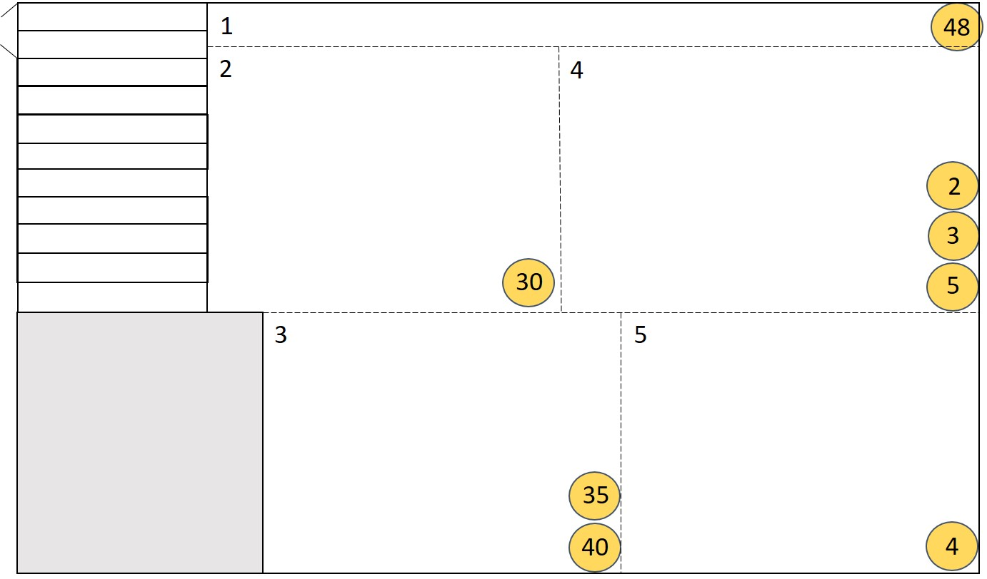
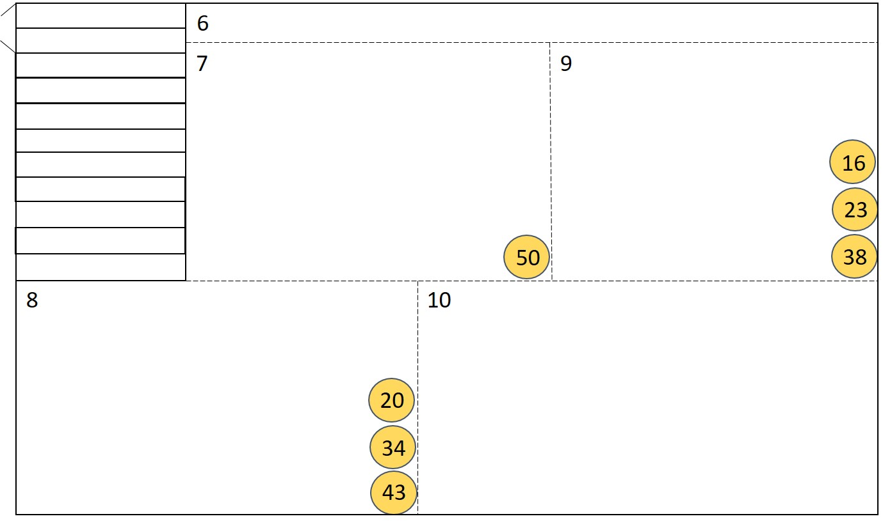
Query #3 Product Location
Yellow circled numbers represent the optimal product placement for each product in each of the 10 locations in the store.
Floor 1
Floor 2
The optimal product locations were determined with AMPL
Overview | Math | SQL | Results

Slide 29
Query #4 Customer Behavior Prediction
Purpose:
Find out the category of products that are likely to be purchased by different customers, during both special and non-special event periods
Business Justification:
The Cal Student Store can recommend different products in their promotional emails, depending on different customer characteristics, to increase sales
Mathematical Model:
Used Machine Learning algorithms such as classification tree, linear modeling, and K-nearest-neighbor to predict customer behavior
Implement more efficient marketing strategy based on customer behavior
Overview | Math | SQL | Results

Slide 30
Query #4 Machine Learning Methods
1. Customer related features:
Is_group, Frat/Sorority, Sports team, Department, … Is_student,
Is_parent, … gender, year, major, region
2. Time related feature:
Date, Special Events (1 if the date is within 10 days before and
after for special event): back_to_school, graduation, sports event
3. Price related features：
Price, promotion, discount, cost
Predictors
Y value - product category
Special Event Item, Decoration item, Office supply, Clothing, Bags, … etc
Overview | Math | SQL | Results

Slide 31
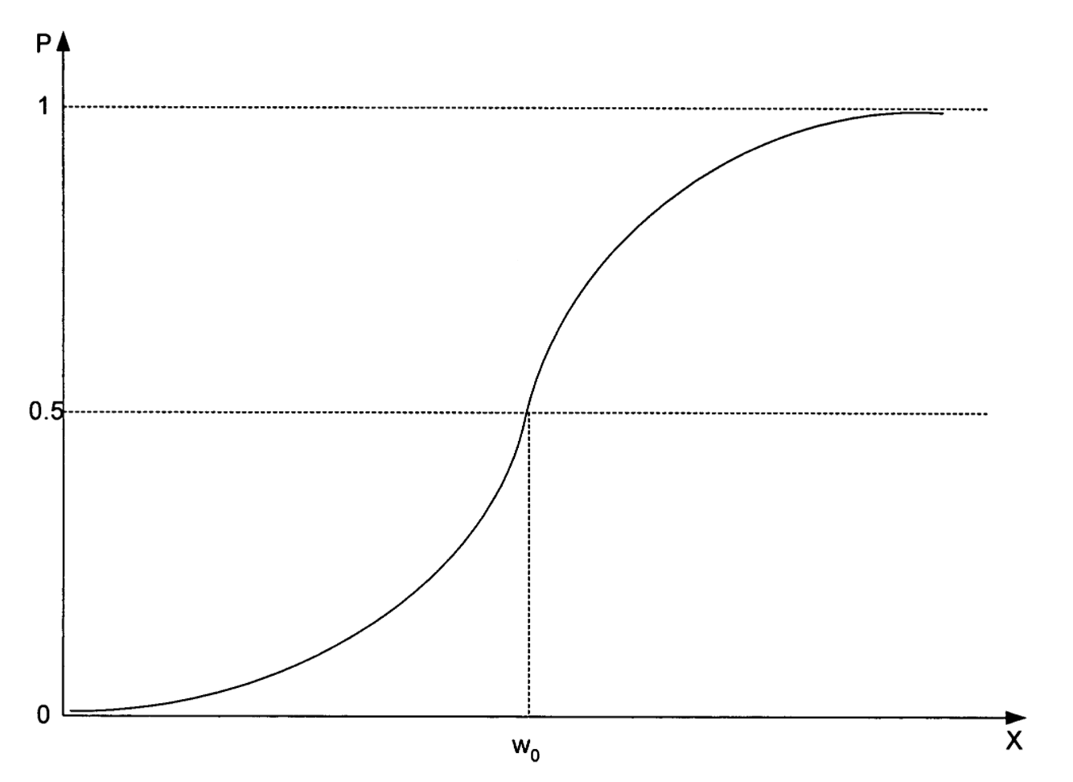
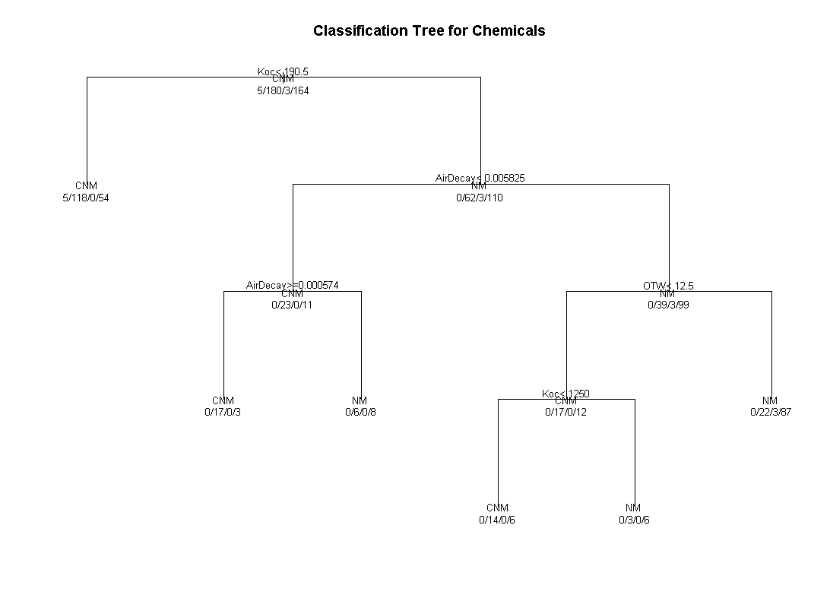
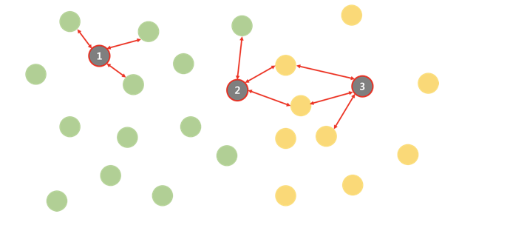
Query #4 Machine Learning Methods
Using extracted data, we will train our model using three classification techniques
1. Classification Tree
2. Logistic Regression Classification
3. K-Nearest-Neighbor Classification
Overview | Math | SQL | Results

Slide 32
Query #4 SQL
SELECT TC.Is_group, TC.group_name, TC.sport_name,
TC.college_name, TC.club_name, IF(C_I.category = “Student” , 1, 0) as Is_Student,IF(C_I.category = “Parent” , 1, 0) as Is_Parent,IF(C_I.category = “Tourist” , 1, 0) as Is_Tourist,IF(C_I.category = “Faculty” , 1, 0) as Is_Faculty,TC.age, TC.gender, TC.year, TC.major, TC.region, T.Date,
IF(T.Date BETWEEN DATEADD( DAY, -10, S.start_date)
AND DATEADD( DAY, 10, S.end_date), 1, 0) as Special_dates,
TP.Quantity, M.Price, D.Amount, P.description, M.Category
FROM
(SELECT C.Is_group, C_SG.group_name, C_SG.sport_name,
C_SG.college_name, C_SG.club_name, C_I.category
C_I.age, C_I.gender,C_I.year,
C_I.major, C_I.region
FROM Transaction as T
LEFT OUTER JOIN Customer as C ON T.CID = C.CID
LEFT OUTER JOIN SpecialGroup as C_SG ON T.CID = C_SG.CID
LEFT OUTER JOIN Individual as C_I ON T.CID = C_I.CID
) as TC,
Transaction as T, Transaction_Products as TP, SpecialEvent as S,
Merchandise as M, Discount as D, Promotion as P
WHERE TC.TID = T.TID AND T.TID = TP.TID AND M.SKU = TP.SKU AND D.DIS_ID = T.DIS_ID AND D.SKU = TP.SKU AND P.SKU = TP.SKU AND P.PID = T.PID
Overview | Math | SQL | Results

Slide 33
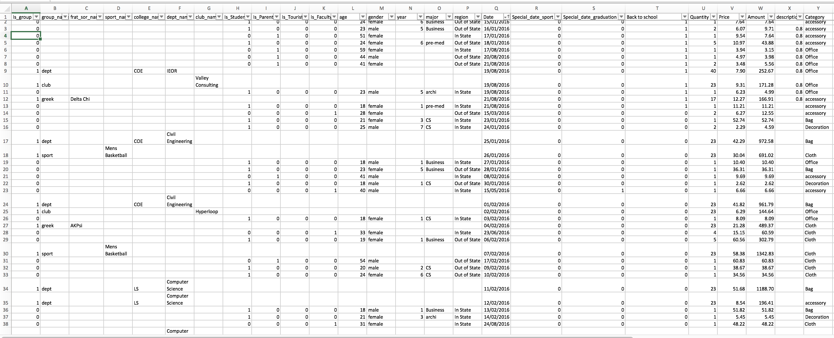
Query #4 SQL Output
Overview | Math | SQL | Results

Slide 34
Query #4 Machine Learning Implementation
Linear Logistic Regression
Non-special Event Period Prediction Accuracy: 42%
Special Event Period Prediction Accuracy: 48%
*KNN method will not be discussed into more details due to low prediction accuracy
Overview | Math | SQL | Results

Slide 35
Query #4 Machine Learning Implementation
Classification Tree
Non-special Event Period Prediction Accuracy: 42%
Special Event Period Prediction Accuracy: 55%
Overview | Math | SQL | Results

Slide 36
Query #4 Machine Learning Implementation
Classification Tree Prediction Examples
During normal time
Individual/Club/Department
College name: COE
During Graduation
Business/CS Major
Not a frat/sorority
Not a tourist
During Sports Events
Male
Architecture Major
Office Items
Special Event Items
Bag
Limitations
Lack of data is the main limitation; the higher availability of the data, the higher the prediction accuracy could be
Overview | Math | SQL | Results

Slide 37
Query #5 Inventory Management
Purpose:
Conduct inventory analysis on time-sensitive products to determine the proper order/re-stock/stock-off time
Business Justification:
Allows Cal Student Store to predict the demand for time-sensitive products so that they can manage the inventory accordingly, given the spatial limit of the Cal Student Store’s storage facilities and set shipping times
Statistical Model:
Fit time series model on the existing data of demand for time-sensitive products to predict future trends, taking into consideration of possible seasonal fluctuation and effects from special events
Help the Cal Student Store strategically place orders and clear inventory
Overview | Math | SQL | Results

Slide 38
Query #5 Time Series Model
1.
ARIMA Model:
Use sequential historical data (SQL) to make future predictions
2.
STL Model:
Decompose time series to observe seasonality and trends
Historical inventory levels calculated based on: Inventory(t) = Inventory(t-1) - Purchase(t) + shipment(t)
Overview | Math | SQL | Results

Slide 39
Query #5 SQL
1.) Determine the top 10 highest selling products in a 3 year period
CREATE VIEW most_popular_items AS
SELECT SKU FROM (
SELECT t.SKU, SUM(tp.Quantity) sales FROM Transaction t, Transaction_Product tp WHERE t.Date IS BETWEEN “2014-01-01 “ AND “2016-12-31” GROUP BY SKU ORDER BY sales DESC
LIMIT 10; )
2.) Find all purchase history for these top 10 products
CREATE VIEW purchase_history AS SELECT t.Date AS date, tp.SKU AS SKU, SUM(t.Quantity) AS purchase FROM Transaction t, Transaction_Product tp WHERE t.TID = tp.TID
AND t.Date IS BETWEEN “2014-01-01 “ AND “2016-12-31”
AND tp.SKU IN most_popular_items.SKU GROUP BY t.Date, tp.SKU ;
3.) Keep track of all shipping information
CREATE VIEW shipment_history AS
SELECT j.SKU AS SKU , s.arrival_date AS date, SUM(s.Quantity) AS shipment FROM Shipment s, Junction_Merch_Order j, Order o
WHERE s.OID = o.OID AND o.OID = j.OID AND s.arrival_date IS BETWEEN “2014-01-01 “ AND “2016-12-31” AND j.SKU IN most_popular_items.SKU GROUP BY date, SKU ;
Overview | Math | SQL | Results

Slide 40
Query #5 Time Series Results
Steps for Time Series Analysis:
1.) T-Shirt Inventory falls below 0 (representing backorders) right around the time period of the Cal-Arizona basketball game
2.) Potential demand not being able to be met
3.) Expand this thinking to full time series
4.) Visually predict cyclical trends in inventory
5.) Cross reference with special events to determine the source of the sales peak
A thorough time series analysis accurately predicts future inventory troughs with historical data
Overview | Math | SQL | Results

Slide 41
Report Content
1
Client Summary
2
Database Design
3
SQL Queries
4
Normalization

Slide 42
Normalization First Normal Form
Schema (Previously):
Transaction (TID, EID⁸, CID⁷, Product(s), Date, Price_amount, Quantity)
Schema (Currently/Fixed):
Transaction (TID, EID⁸, Date, Total_Price)
Transaction_Products (TID⁹, SID¹, Quantity)
Added an extra table to take care of the multi-valued attribute Product(s)
Schema (Previously):
Parent (CID⁷, child_name, num_of_child_attending)
Schema (Currently/Fixed):
Parent(CID⁷, num_children_attending)
Parent_cust_children (CID⁹, child_SID, child_name, child_year)
Added an extra table to take care of the multi-valued attribute child_name

Slide 43
Normalization Second Normal Form
Schema (Previously):
Shift_worker (Shift_ID²³, Worker_ID⁸, Worker_type)
Schema (Fixed):
Shift_worker (Shift_ID²³, Worker_ID⁸)
Removed attribute Worker_type. Determined by Worker_ID, already in Employee table
Schema (Previously):
Discount (DIS_ID, Dis_start_date, Dis_end_date, Dis_type_ID¹³, SKU¹, Amount)
Schema (Currently/Fixed):
Discount (DIS_ID, Dis_start_date, Dis_end_date, Dis_type_ID¹³, SKU¹, Amount)
Made Dis_start_date and Dis_end_date non-prime attributes since DIS_ID determined all
non-prime attributes

Slide 44
Normalization Third Normal Form
Schema (Currently):
Office Supply Item (SKU¹, Name, Size, Color, Ink, Tip_size, Pack_size, Paper_style, Notebook_style, Folder_material, Page_num)
Schema (Optional Recommendation):
Office Supply Item (SKU¹, Name, Size, Color, Ink, Tip_size, Pack_size, Paper_style, Notebook_style, Folder_material)
Notebook (Notebook_style, Page_number)
Added an extra table since Notebook_style (non-prime attribute) determined Page_number (non-prime attribute)

Slide 45
THANK
YOU!

